Slide 1
In/Near-Memory Processing
A look into "A Logic-in-Memory Computer”, IEEE Trans. Comput., 1970.

Slide 2
Background
Rent’s Rule
Cost of microelectronic modules is strongly associated with number of pins, not gates.
Increase in hardware complexity will be feasible
Start with memories!

Slide 3
Goals
Show how to use a logic in-memory array as a high speed buffer (essentially a cache memory)
  Uses the IBM 360/85
Show a new direction in computer architecture

Slide 4
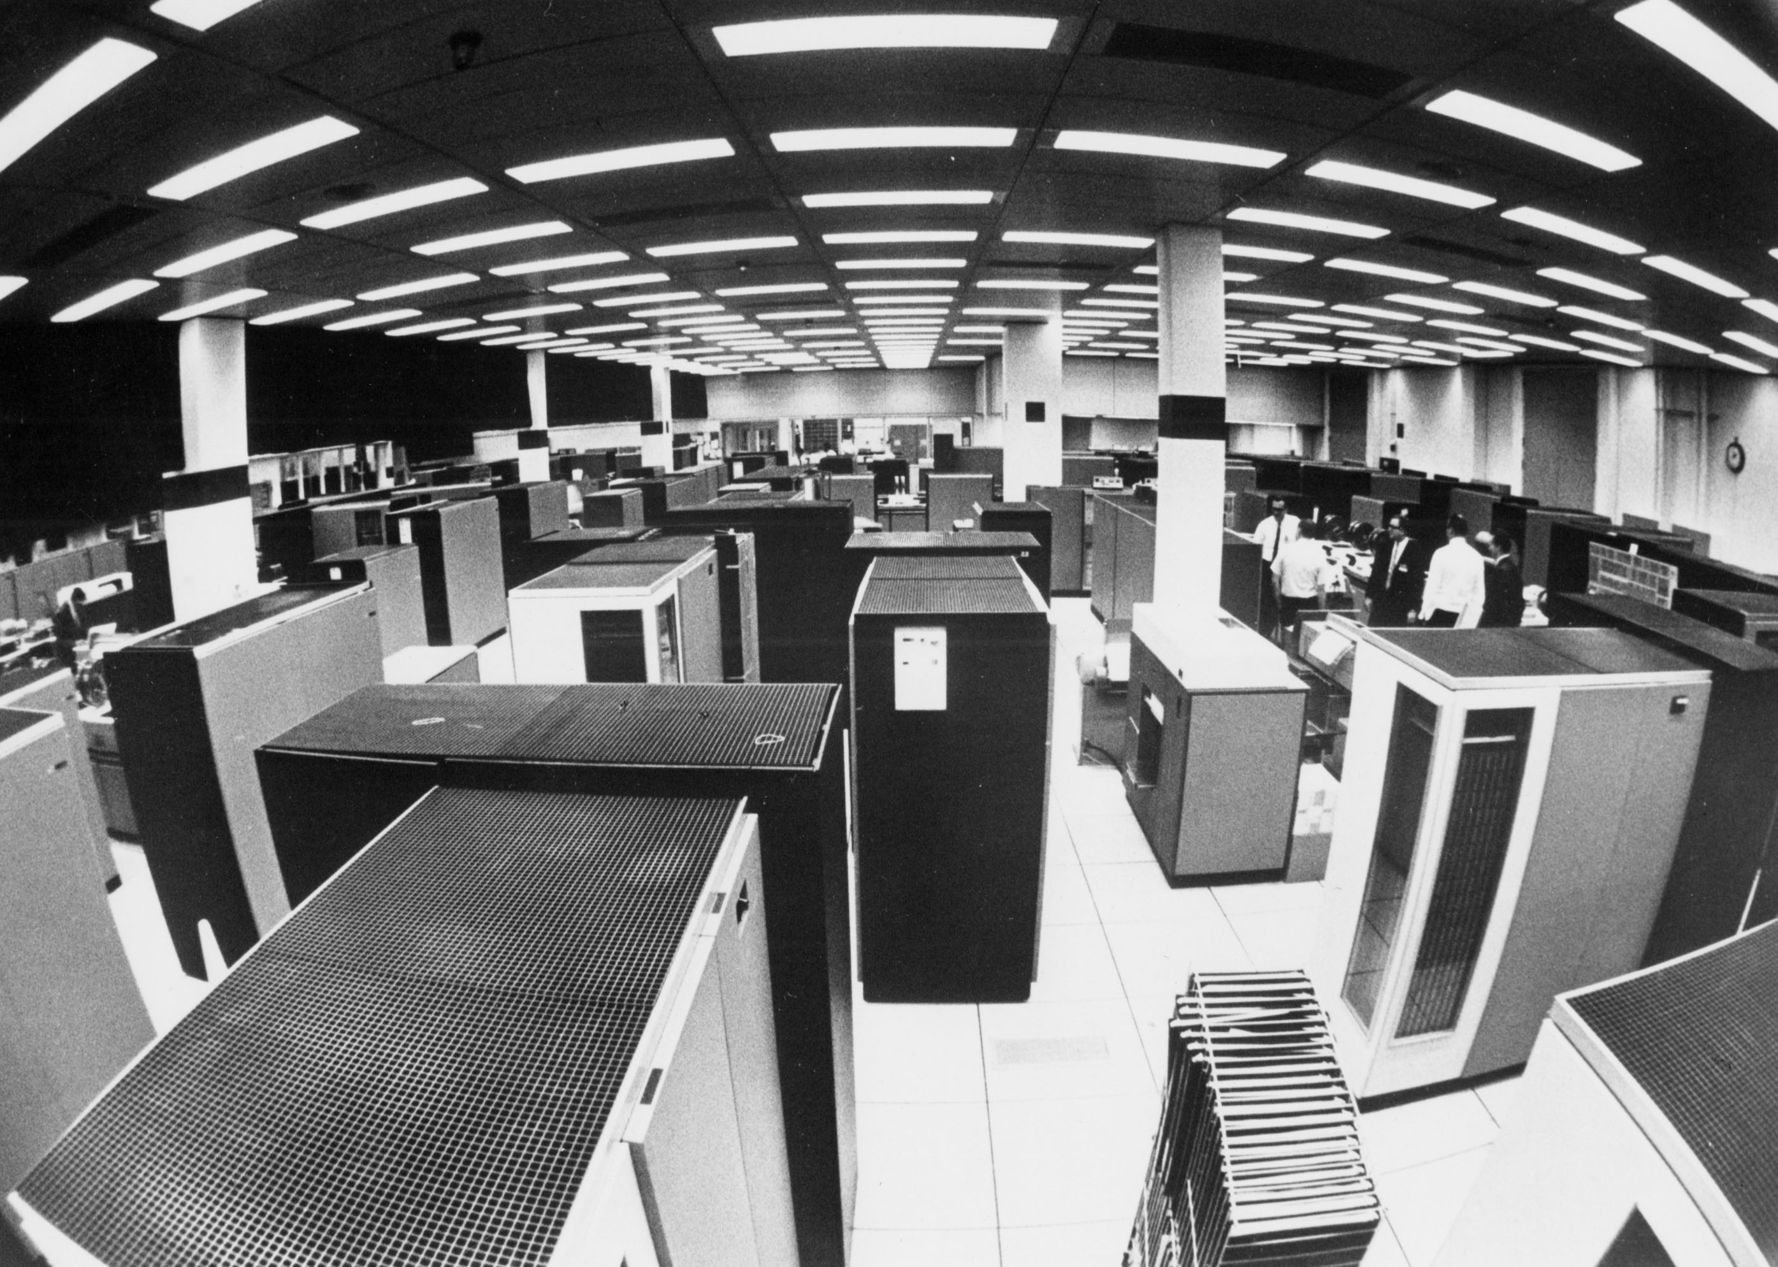
Pioneering
This was written in 1970!

Slide 5
Cache-Organized Computer
CPU
CACHE
STORAGE CONTROL
MAIN MEMORY

Slide 6
Cache-Organized Computer
CPU
CACHE
STORAGE CONTROL
MAIN MEMORY
90 ns
750-8000 ns

Slide 7
Cache Specifications
16KB, 16-word (fully?) associative memory
  16 sectors of memory
  LRU

Slide 8
Main Memory – Cache Communication
64 byte “blocks” (4*16 byte “words”) are moved, 16 blocks in a sector
???
Move a sector to cache → ~10 main memory cycles

Slide 9
Benefits?
Not tested at the time of writing on IBM 360/85
Through simulation:
  95% of requests were already in cache
  Total performance at 80% of computer with microelectronic memory!
Conclusion: microelectronic memories can be embedded effectively

Slide 10
Logic-in-Memory
Cache memory makes main memory seem as it has the cache performance
Enhance cache with some logic-in-memory operations
  CPU can expect to find needed sectors in cache → Operations will succeed

Slide 11
Proposed Operations
Utility of instructions?
  Illustrative of all possible operations
  Empirically common to many programs complex operations
Cost of implementation?

